Slide 1

MEDICAL MIRROR
Submitted by
K . Yamini Durga
14PA5A0418

Slide 2
CONTENTS
Introduction
History
Design of medical mirror
How does the technology works
Working
Advantages
Disadvantages
conclusion

Slide 3
INTRODUCTION
Medical mirror is also known as Magical mirror that displays our heartbeat.
Current techniques for physiological monitoring typically require users to strap on bulky sensors, chest straps or sticky electrodes.
A new mirror interface for real-time, contact-free measurements of heart rate without the need for external sensors.

Slide 4

HISTORY
Invented by Ming -Zher poh in MIT Media Lab in 2009.
In 2009, Ming-Zher Poh and his roommate, Dan McDuff, asked some friends to sit in front of a laptop. He is electrical and medical-engineering graduate student at
the Massachusetts Institute of Technology (MIT), was trying to transform the computer’s webcam into a heart-rate monitor.
After one year, there was a large framed mirror sits in the MIT Media Lab. Behind the two-way glass, a webcam-equipped monitor is wired to a laptop.

Slide 5
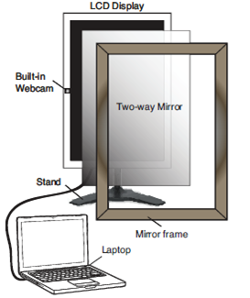
Design of a Medical Mirror

Slide 6
Medical Mirror to provide a natural user Interface.
An LCD monitor with a built-in webcam to provide an interactive display.
A two-way mirror was fitted onto the frame to present a reflective surface for the users in normal lighting conditions.
The user is visible to the webcam and the LCD monitor can be used to project information onto the reflective surface of the mirror.
The monitor and webcam are connected to a laptop running the analysis software in real-time.

Slide 7
How does this technology work??
It uses light to measure the information from your body.
Every time your heart beats, the blood in your vessels increases very slightly.
Blood absorbs light and so this increase absorbs more mono light, decreasing the amount of light being transmitted or reflected by your body.
It detects only human face and ignores anything else such as human body, building etc.
In this case we're just using the ambient light around you: sunlight, room light or anything that's illuminating your environment.
The camera then measures the mono light being reflected off you, in this case, your face.

Slide 8
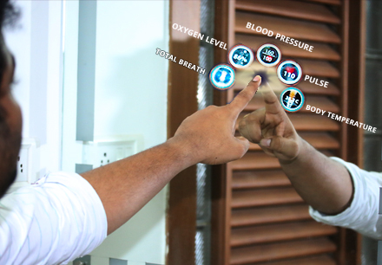
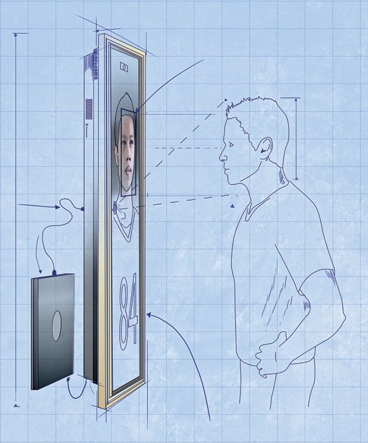

Slide 9
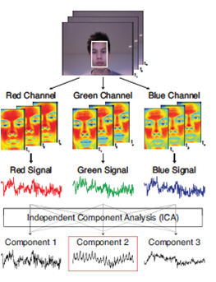
working
An automated face tracker detects the largest face within the video feed from the webcam and localizes the measurement region of interest (ROI) for each video frame.
The raw RGB signals are decomposed into three independent components using independent component analysis.

Slide 10
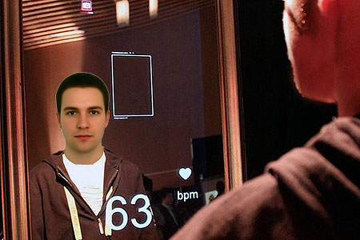

Slide 11
ADVANTAGES
The main advantage of this method is very low cost compared with other methods.
Blending the data collection process into the course of our daily routines.
By using this we can track our daily routine with minimal effort.
You could also use it on a phone or laptop or any device that has a camera.

Slide 12
DISADVANTAGES
A single user will be able to interact with the mirror at a time.
medical mirror is that continuous heartbeat measurement like ECG technology is not possible.
We have to wait a time period of 15 seconds to get heartbeat count.

Slide 13
conclusion
This technology shows an advanced approach to users health monitoring depends upon the state of the art technology. The Medical Mirror turns effortlessly into the home environment for data collection process into the course of our daily life.

Slide 14
REFERENCES
https://www.mepits.com/tutorial/176/Biomedical/Medical-Mirror
http://www.seminarsonly.com/electronics/medical-mirror-seminar.php

Slide 15


